Slide 1

Machine Learning
Classifier Performance Evaluation
Pramote Kuacharoen

Slide 2


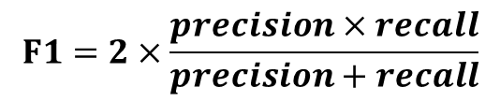

Confusion Matrix
Predicted Class
 | Class 0 | Class 1
Class 0 | True Negatives (TN) | False Positive (FP)
Class 1 | False Negative (FN) | True Positive (TP)
Actual Class
Accuracy: $\frac{TP+TN}{TP+TN+FP+FN}$
Precision: $\frac{TP}{TP+FP}$
Recall: $\frac{TP}{TP+FN}$
$$F1=2×\frac{precision×recall}{precision+recall}$$

Slide 3


ROC Curve
An ROC curve (receiver operating characteristic curve) is a graph showing the performance of a classification model at all classification thresholds
Lowering the classification threshold classifies more items as positive, thus increasing both False Positives and True Positives
1
True positive rate: $\frac{TP}{TP+FN}$
False positive rate: $\frac{FP}{FP+TN}$
TP Rate
FP Rate
1

Slide 4
ROC Curve
Plot of the true positive rate versus the false positive rate
Probability thresholds ranges from 0 to 1
If probability of the positive class is greater than or equal the threshold
Positive class is assigned
Otherwise, it is negative
1
TP Rate
FP Rate
1

Slide 5
AUC: Area Under the ROC Curve
AUC measures the entire two-dimensional area underneath the entire ROC curve (think integral calculus) from (0,0) to (1,1)
AUC provides an aggregate measure of performance across all possible classification thresholds
AUC ranges in value from 0 to 1
A model whose predictions are 100% wrong has an AUC of 0.0
One whose predictions are 100% correct has an AUC of 1.0
AUC is desirable for the following two reasons:
AUC is scale-invariant. It measures how well predictions are ranked, rather than their absolute values
AUC is classification-threshold-invariant. It measures the quality of the model's predictions irrespective of what classification threshold is chosen

Slide 6
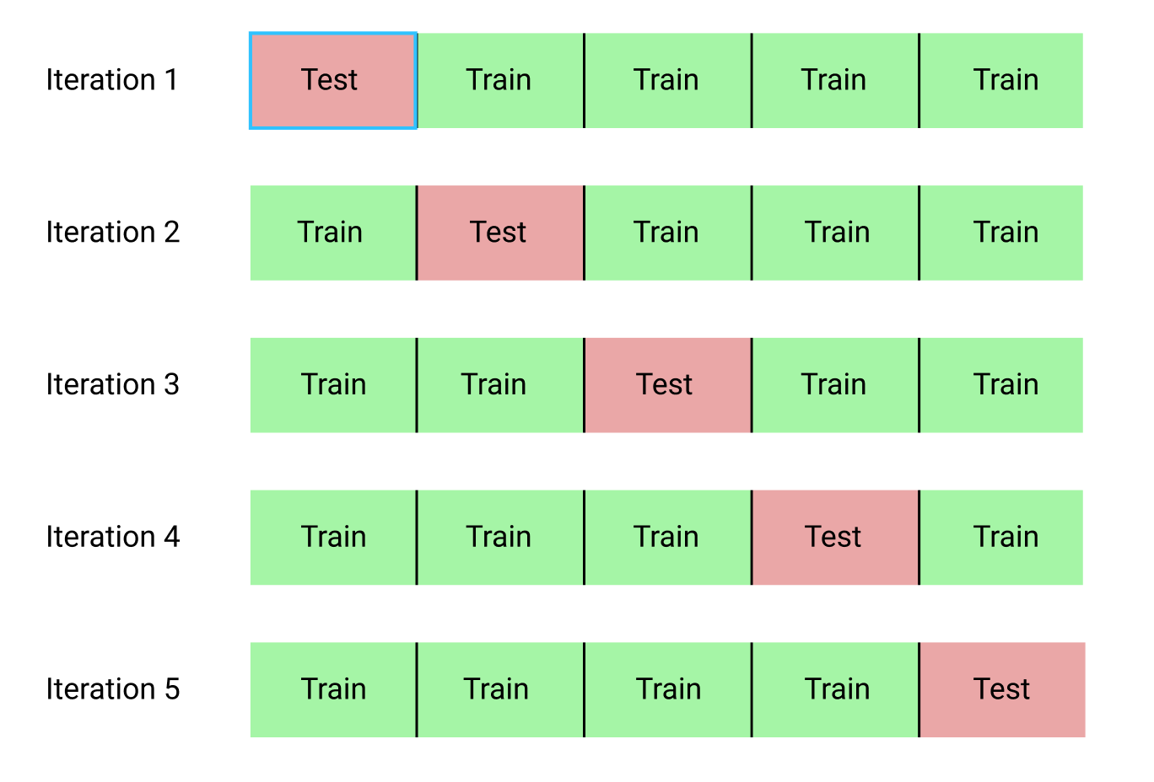
Cross-Validation
The goal of cross-validation is to test the model’s ability to predict new data that was not used in estimating it
K-fold cross-validation
the original sample is randomly partitioned into k equal sized subsamples. Of the k subsamples, a single subsample is retained as the validation data for testing the model, and the remaining k − 1 subsamples are used as training data
The cross-validation process is then repeated k times, with each of the k subsamples used exactly once as the validation data
Stratified k-fold cross-validation
the folds are selected so that the mean response value is approximately equal in all the folds
the process of rearranging the data as to ensure each fold is a good representative of the whole

Slide 7
Model Tuning
Average performance over k-fold cross-validation is an accurate estimate
The goal of model tuning or model selection is to pick a set of parameters
The best average performance must be achieved
Movie Review Data: http://www.cs.cornell.edu/people/pabo/movie-review-data/

Slide 8
Question?
Insert Image

